Slide 1


Slide 2
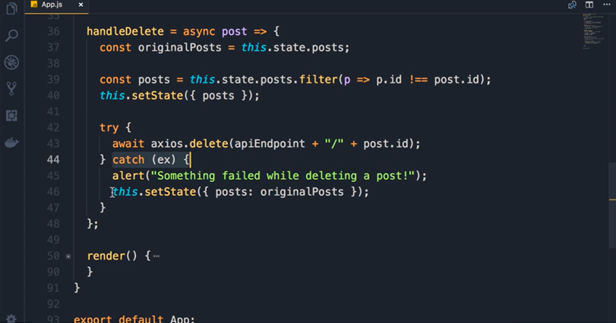

Slide 3
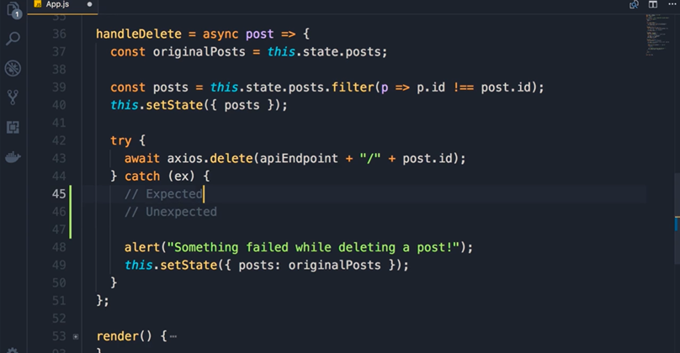
Expectec errors are errors api end points can predict and return

Slide 4
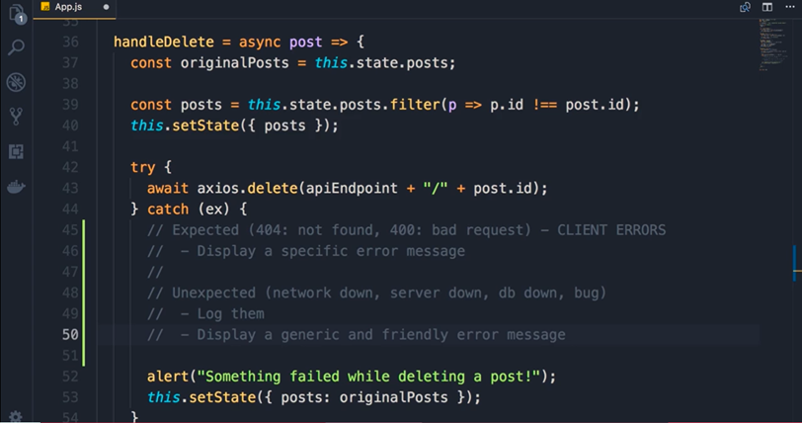
Example if you try to delete a id which is not there then the error is 404 not found or when you submit invalid data the error is 400 bad request

Slide 5
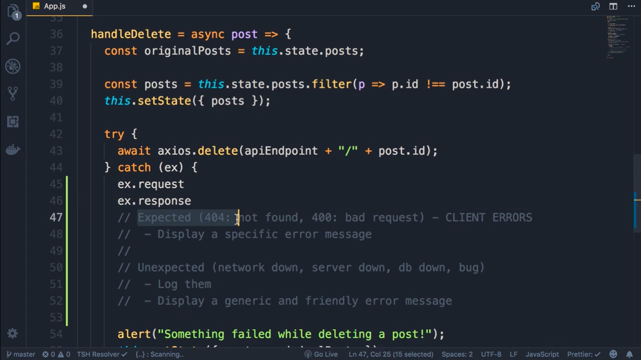

Slide 6
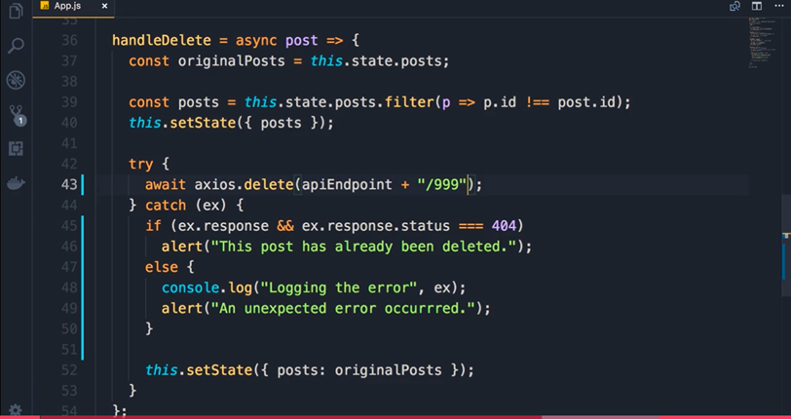
We are simulating erroor by adding /999

Slide 7
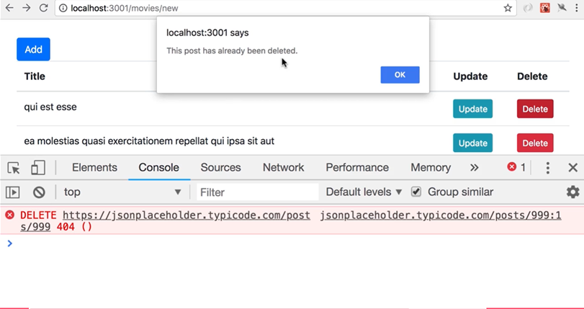

Slide 8
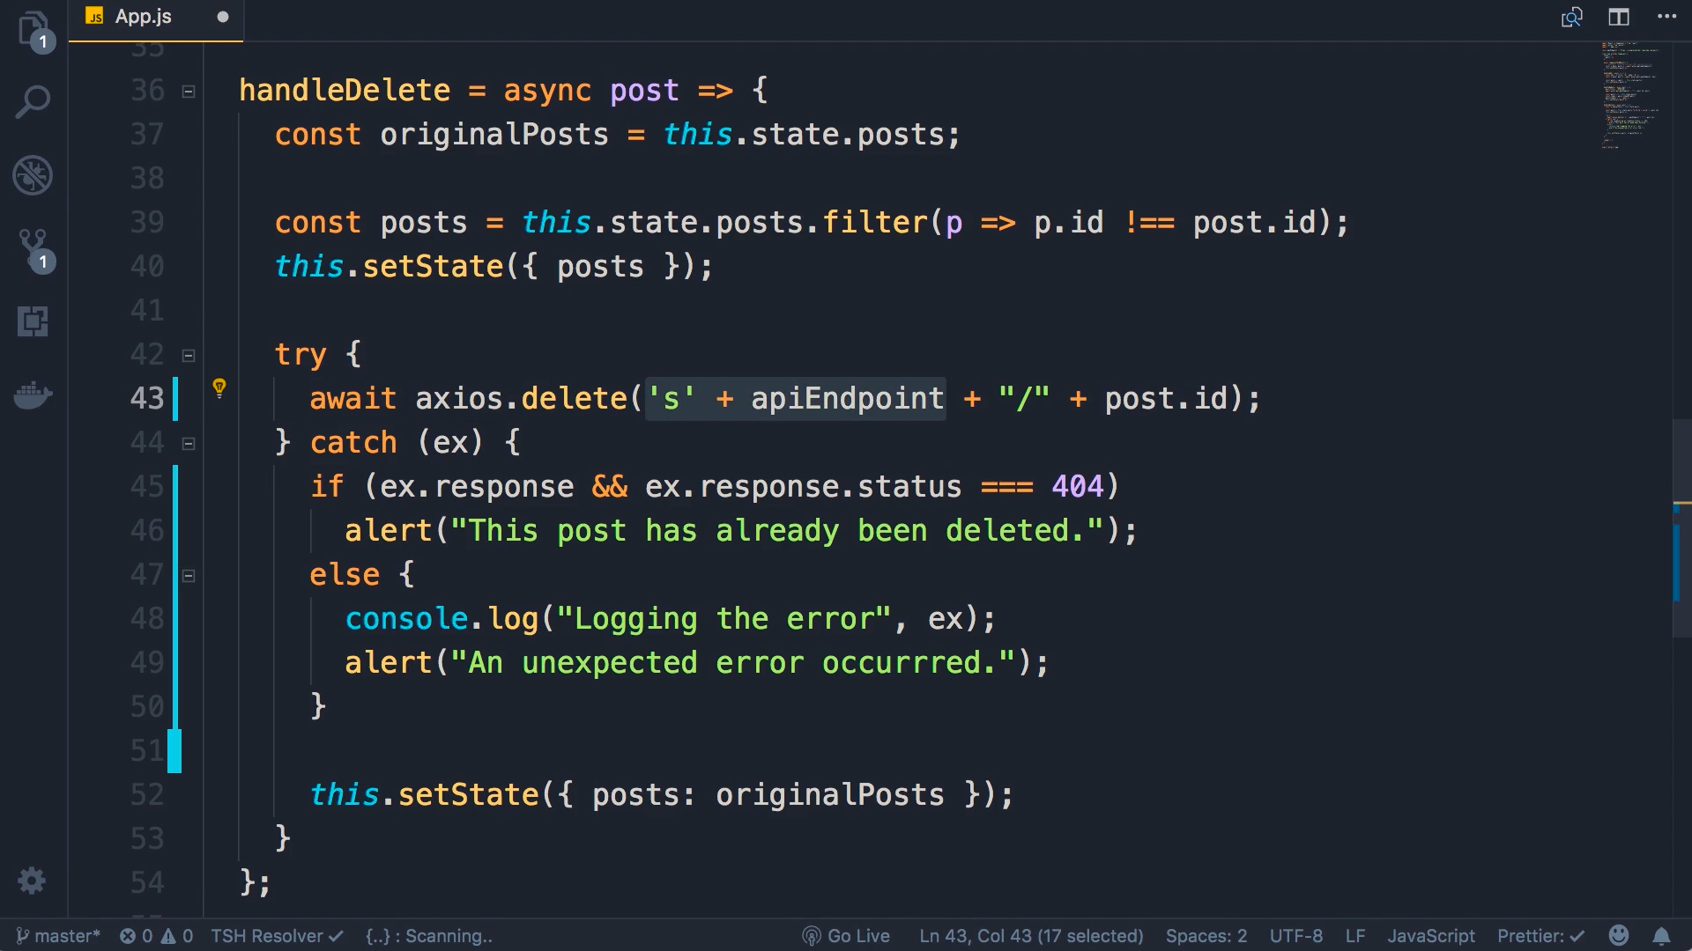

Slide 9
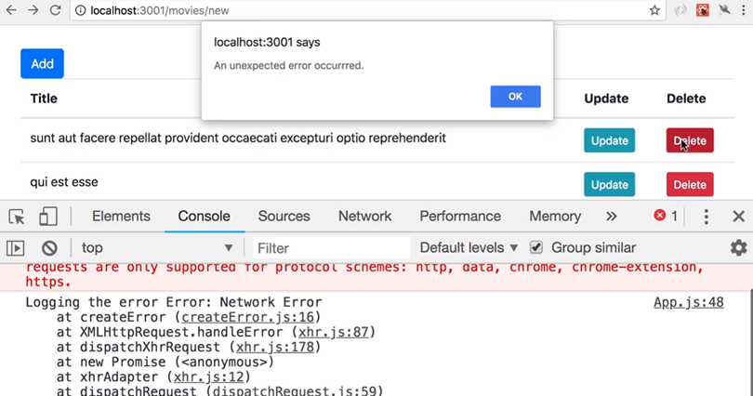

Slide 10
